Slide 1

Analyzing Consumer Behavior for In-Vehicle Coupon Acceptance
A Machine Learning Approach for Binary Class Problem

Slide 2


AGENDA
01
02
03
04
Introduction
Data PreProcessing
Exploratory Data Analysis(EDA)
Modelling

Slide 3


Importance of personalized marketing using Machine Learning Approach

Slide 4

Introduction
Personalized marketing is crucial for boosting customer engagement and sales in the competitive automotive industry.
This project aims to develop a robust in-vehicle coupon recommendation system leveraging machine learning techniques.
The system will personalize coupon offers based on individual customer profiles and contextual factors.
We will employ various machine learning models, evaluate their performance, and select the best-performing model.
The final goal is to improve coupon redemption rates and enhance customer satisfaction.
Notes:
-
- Making travel more

Slide 5


DATASET OVERVIEW
12,684 X 26
Data Source : Amazon Mechanical Turk
Feature types: A mix of categorical (e.g., gender, car make) and numerical (e.g., age, income, distance driven) comprising of both Contextual and Demographic data.
DATA SET SIZE
CATEGORICAL : 18
NUMERICAL : 8

Slide 6
Dataset Description
Attribute | Description
destination | User's destination
passanger | Passengers accompanying the user
coupon | Type of coupon offered
expiration | Validity of the coupon
occupation | User's profession
RestaurantLessThan20 | Frequency of visiting restaurants with average expense < $20 per month
Restaurant20To50 | Frequency of visiting restaurants with average expense $20-$50 per month
toCoupon_GEQ15min | Whether the coupon location is more than 15 minutes away
toCoupon_GEQ25min | Whether the coupon location is more than 25 minutes away
direction_same | Whether the restaurant/bar is in the same direction as the user's current destination
direction_opp | Whether the restaurant/bar is in the opposite direction of the user's current destination
Y | Whether the coupon was accepted
Target Variable

Slide 7

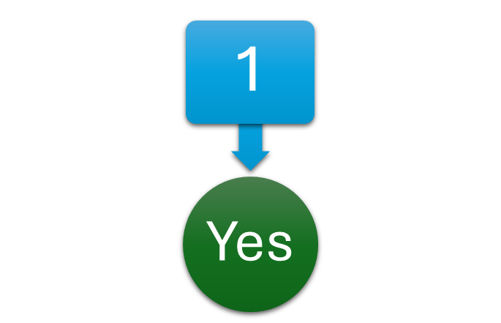
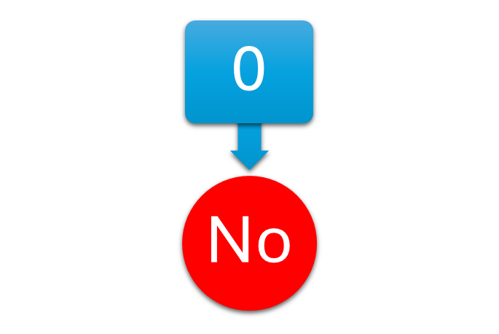
TARGET VARIABLE
Accepted
Rejected

Slide 8
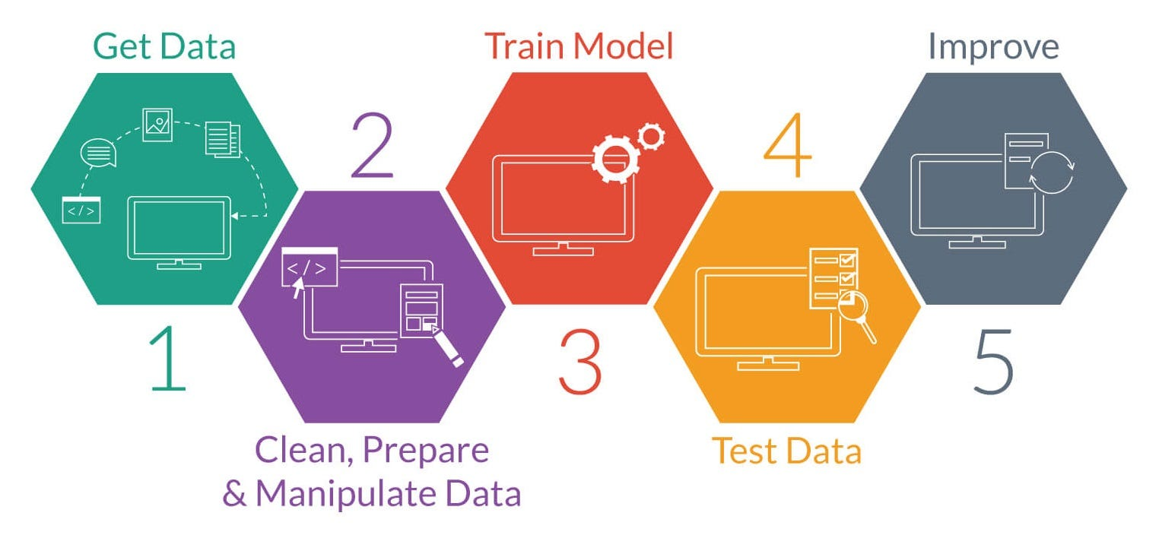

Slide 9
DATA
PRE PROCESSING

Slide 10
DATA PRE-PROCESSING
DUPLICATE VALUES
MISSING VALUES
Notes:
-
- Making travel more

Slide 11

Missing Values
Feature | Total | Percent
Car | 12,502 | 99.14%
Coffee House | 217 | 1.72%
Restaurant20To50 | 189 | 1.50%
Carry Away | 150 | 1.19%
Restaurant Lessthan20 | 129 | 1.02%
Bar | 107 | 0.85%

Slide 12
Exploratory Data Analysis

Slide 13
EXPLORATORY DATA ANALYSIS
01
02
03
Analyzed coupon acceptance rates across different demographics (age, education ,income).
Visualizations included bar charts, histograms, and scatter plots.
Discovered significant correlations between coupon acceptance and factors like age, income, and driving habits.
04
05
Identified potential outliers and investigated their impact on model performance.
Conducted bivariate analysis to explore relationships between pairs of features, e.g., the relationship between income and coupon acceptance rate for different age groups.

Slide 14
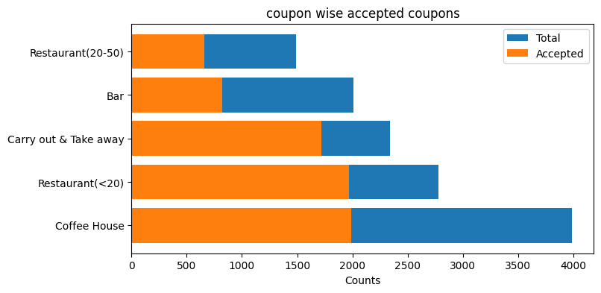
Exploring Coupon Acceptance Trends

Slide 15
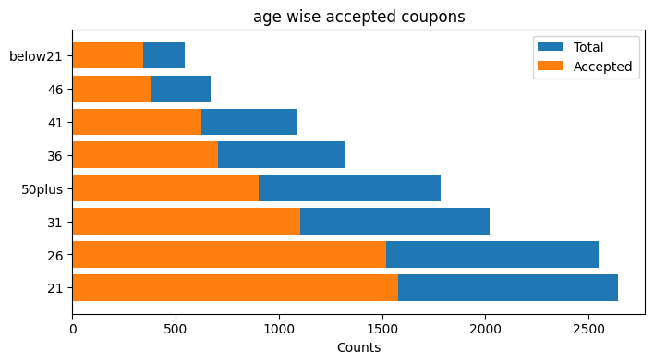
Age-Wise Analysis of Coupon Acceptance

Slide 16
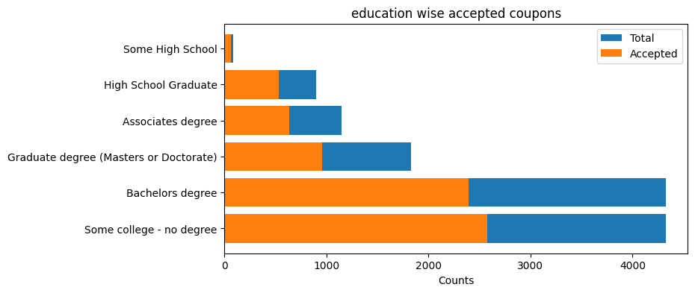
Analyzing Coupon Acceptance trends- Education
Exploring Coupon Acceptance Trends

Slide 17
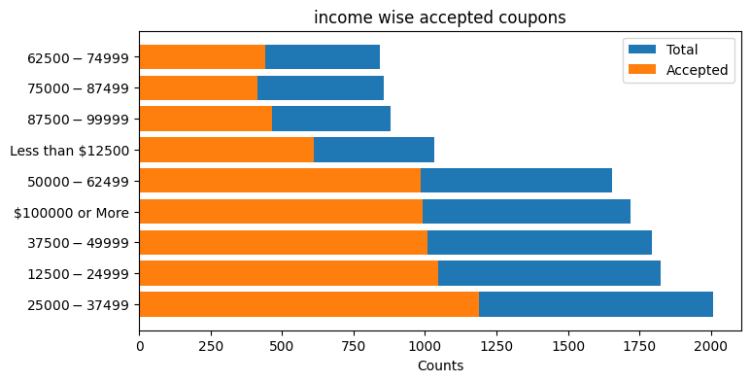
Analyzing Coupon Acceptance trends- Income

Slide 18
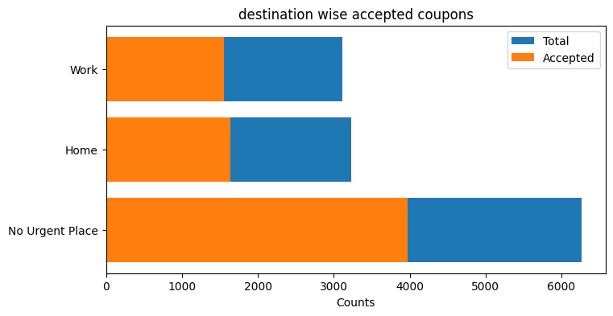
Analyzing Coupon Acceptance trends- Destination

Slide 19

Bi-Variate Analysis

Slide 20
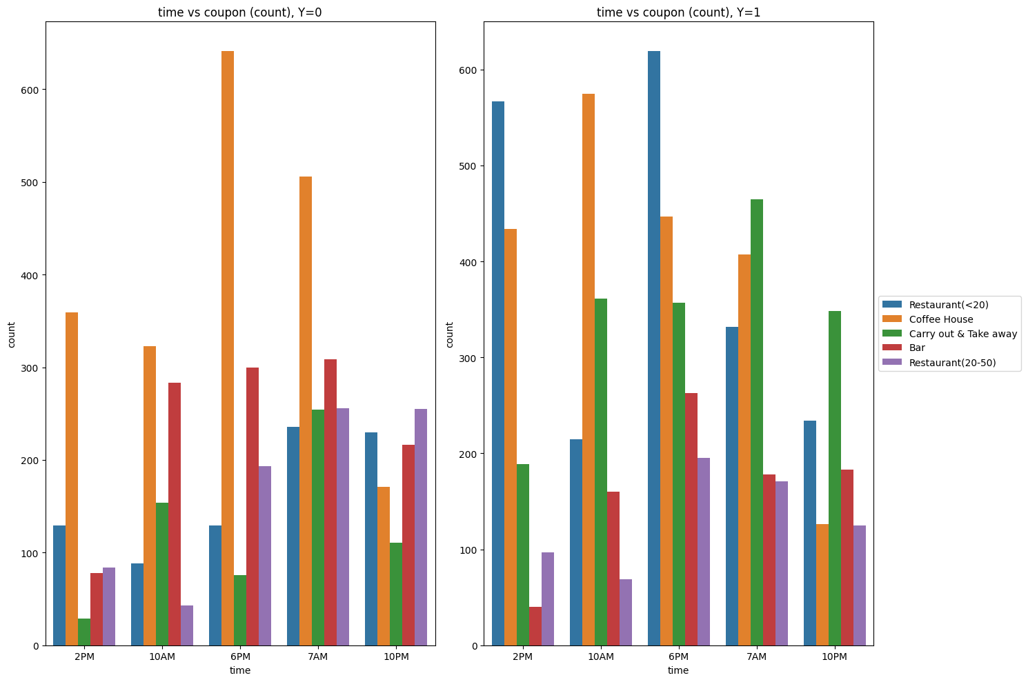
Across Different Business Types and Time of Day

Slide 21
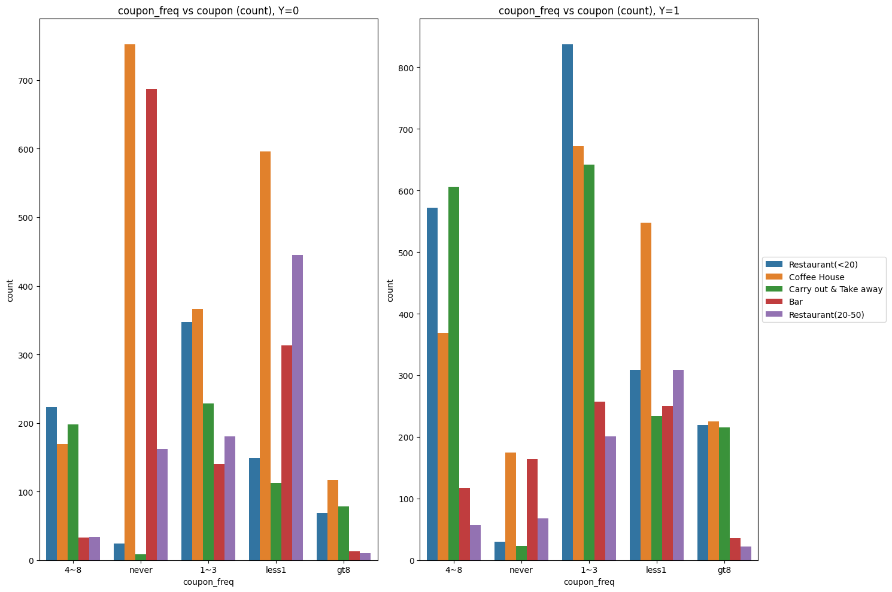
Frequency and Counts Across Business Types

Slide 22

Feature Engineering
Label Encoding
Ordinal Encoding

Slide 23

MODELLING

Slide 24
Feature Scaling
Standard Scaler

Slide 25
DATA SPLIT
80% :Train
20% :Test

Slide 26
Model Performance
XGBoost's feature importance scores indicated that COUPON FREQUENCY, EXPIRATION, DESTINATION, WEATHER were the most influential factors in predicting coupon redemption.
This information is critical for understanding customer behavior and tailoring future marketing campaigns.
This analysis helps refine future marketing strategies by focusing on the most impactful features.
This understanding allows for more targeted and efficient resource allocation in marketing campaigns.

Slide 27
MODEL PERFORMANCE METRICS
Model | Accuracy | Precision | Recall | F1 Score | AUC-ROC
Logistic Regression | 70.74% | 73.19% | 78.57% | 75.79% | 73.57%
Random Forest | 73.43% | 76.29% | 79% | 75.79% | 79.34%
Support Vector Machine (SVM) | 71.09% | 73.46% | 78.91% | 76.09% | 73.48%
K-Nearest Neighbors (K-NN) | 68.56% | 72.34% | 74.56% | 73.43% | 71.47%
XGBoost(Tuned) | 74.62% | 77.27% | 80.00% | 78.61% | 81.69%

Slide 28
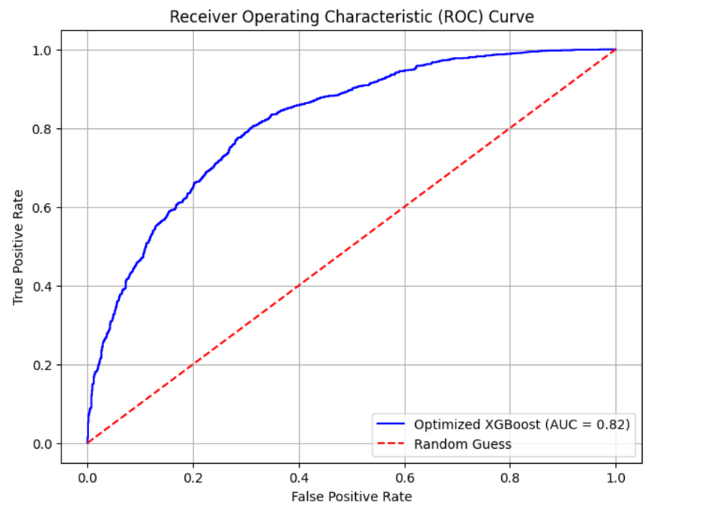
AUC-ROC Curve

Slide 29


Fine - Tuning
Optimized using Optuna

Slide 30
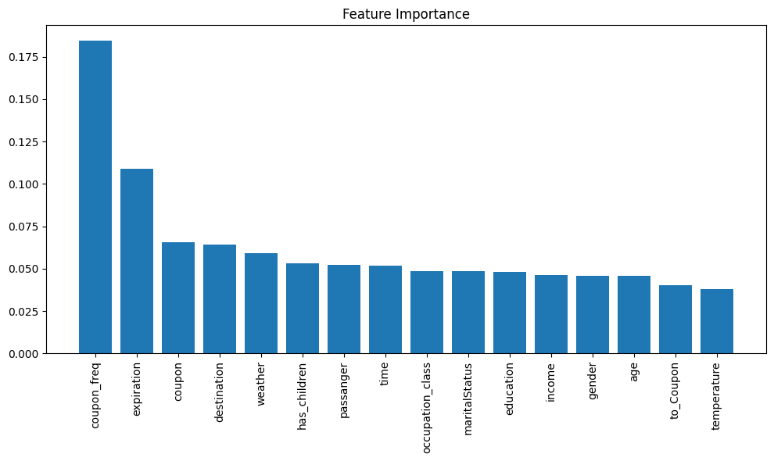
Feature Importance

Slide 31

Conclusion and Future Work
This project successfully developed a robust in-vehicle coupon recommendation system using machine learning.
1
2
XGBoost was identified as the best-performing model, providing accurate predictions of coupon redemption.
Future work includes real-time deployment of the system, enriching the dataset with additional information (e.g., location data, real-time traffic conditions), and exploring advanced personalization techniques (e.g., reinforcement learning).
3
Continued improvements to the system will leverage new data sources and advanced techniques to further optimize coupon delivery and increase redemption rates.
4
Incorporating user feedback mechanisms can significantly improve the system's accuracy and relevance over time.
5

Slide 32


Slide 33

Thank you

